Slide 1
AME20216 - Lab I L3 - Transducers

Slide 2
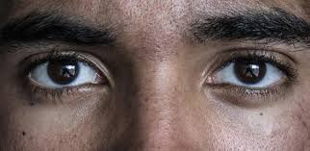

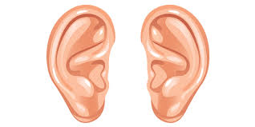

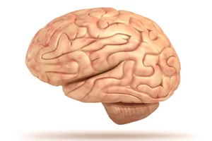
Stay engaged. Take notes in lecture.

Slide 3
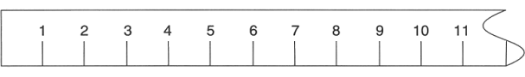
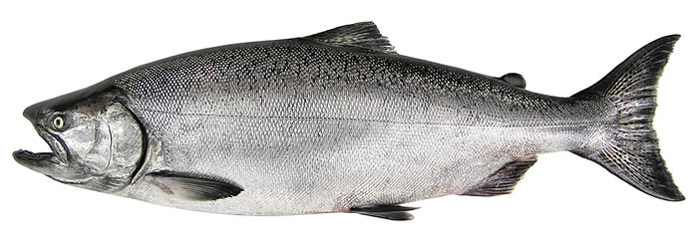
A1 – Meter Stick Measurements
The meter stick is one of the most basic scientific instruments.
cm
L = 9.4 ± 0.5 cm

Slide 4
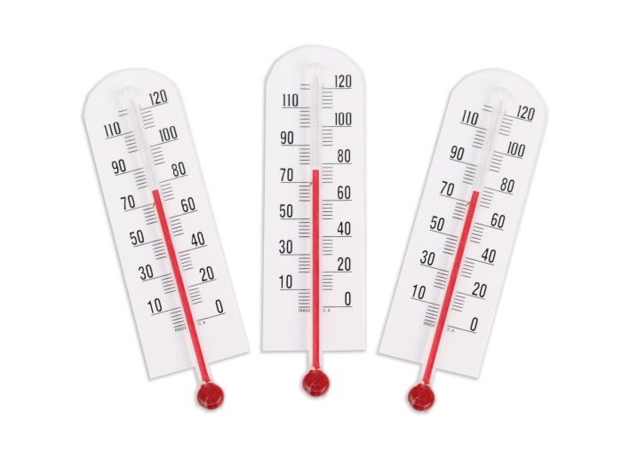
Transducer
Converts one physical stimulus to another.
Example: Alcohol thermometer
TEMPERATURE
LENGTH

Slide 5
U-tube Manometer
Transducer converts pressure to length.
PRESSURE
LENGTH

Slide 6
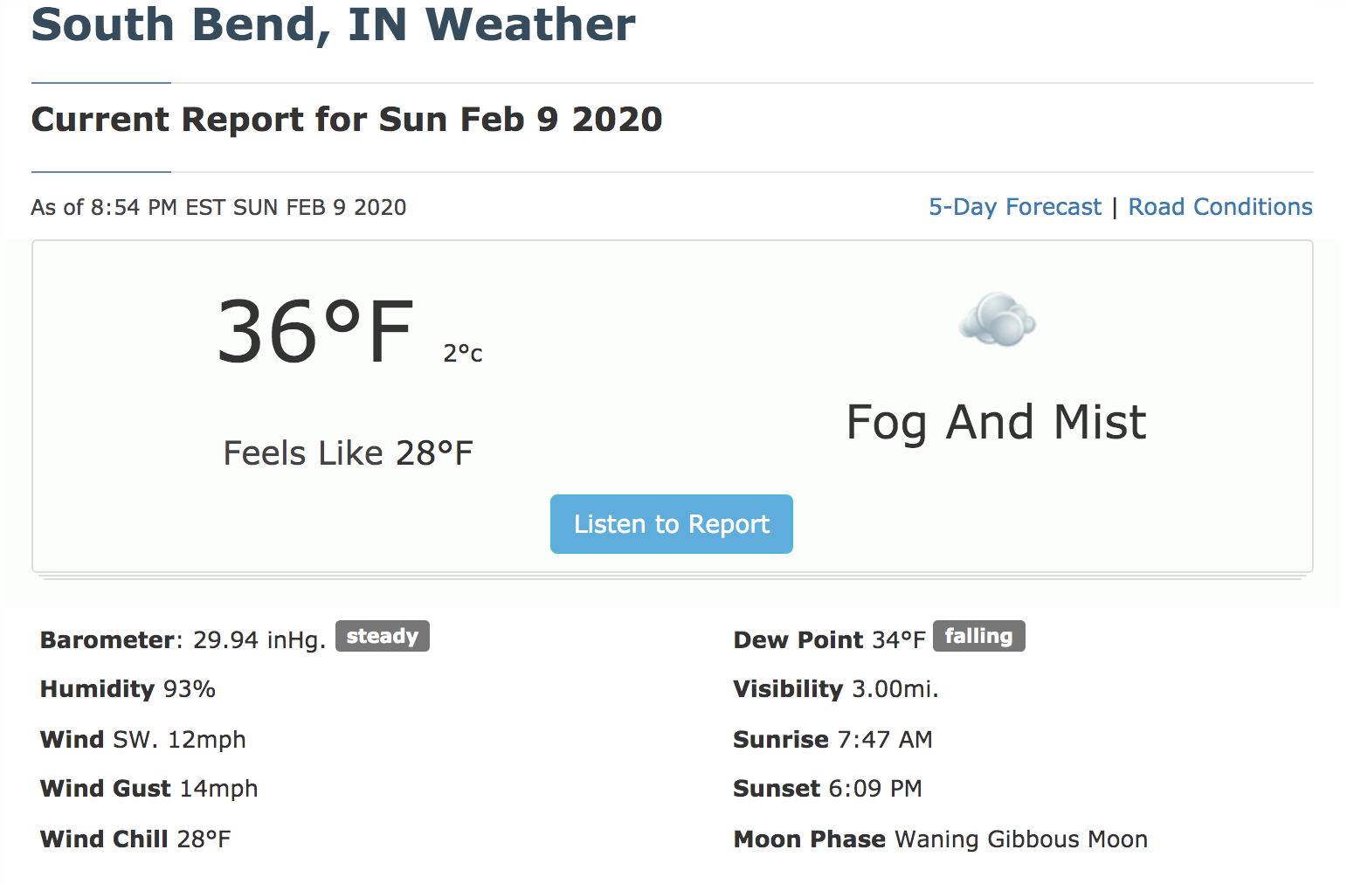

Slide 7
Definitions
Gauge pressure – pressure relative to surrounding air
Absolute pressure – pressure relative to a complete vacuum
Sensitivity – (Change in legnth) / (Change in pressure)
Range – max value an instrument can measure

Slide 8
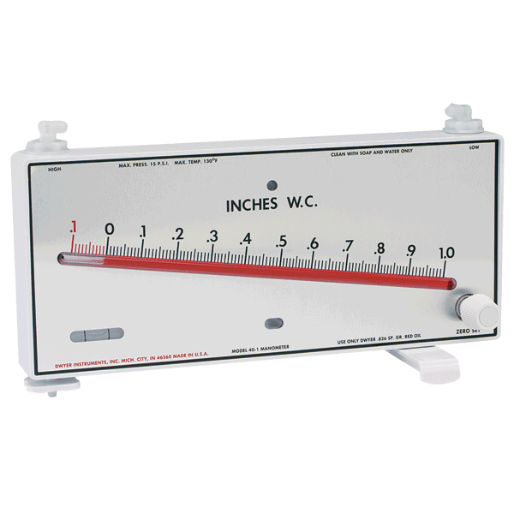
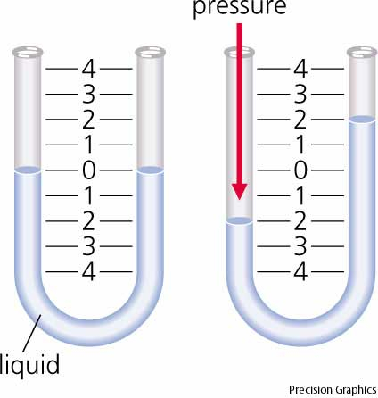
Sensitivity
U-tube Manometer
Less sensitive
Greater range
Inclined Manometer
More sensitive
Less range
http://www.dwyer-inst.com

Slide 9
Pitot Static Probe
Pitot probe converts airspeed to pressure.
Manometer converts pressure to length.
AIRSPEED
PRESSURE
LENGTH
u = “airspeed”
p₁ = “stagnation pressure”
p₂ = “static pressure”
Bernoulli:

Slide 10
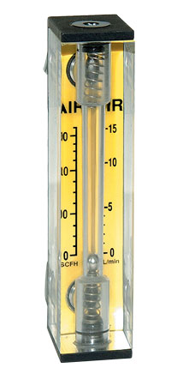
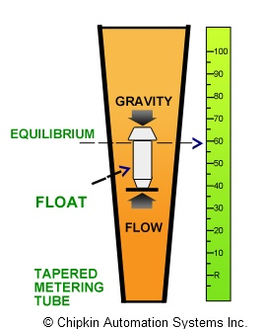
Rotameter
Measures flow rate.
Viscous drag causes a bead to levitate at a certain height.
Omega.com

Slide 11
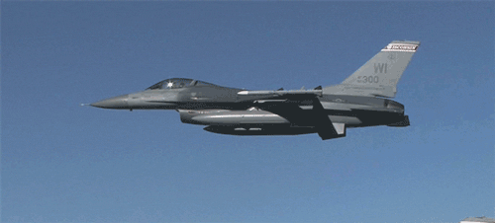
Electronic Transducers

Slide 12
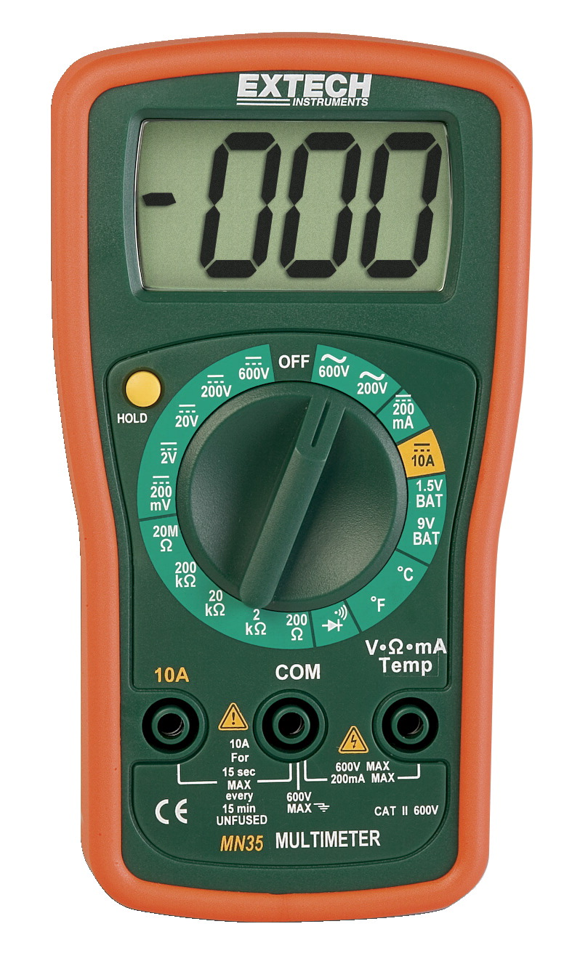
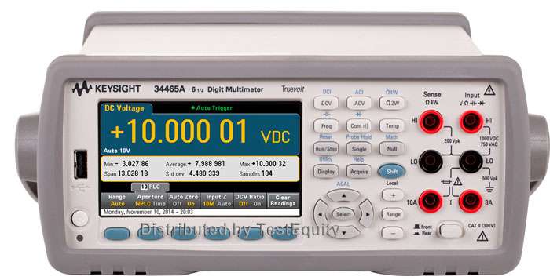
Electronics
Extech Handheld DMM
Keysight Precision DMM

Slide 13
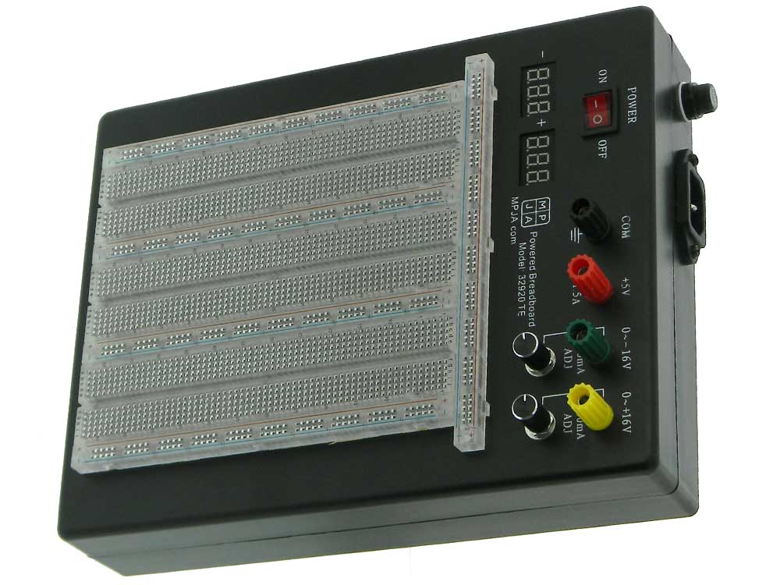
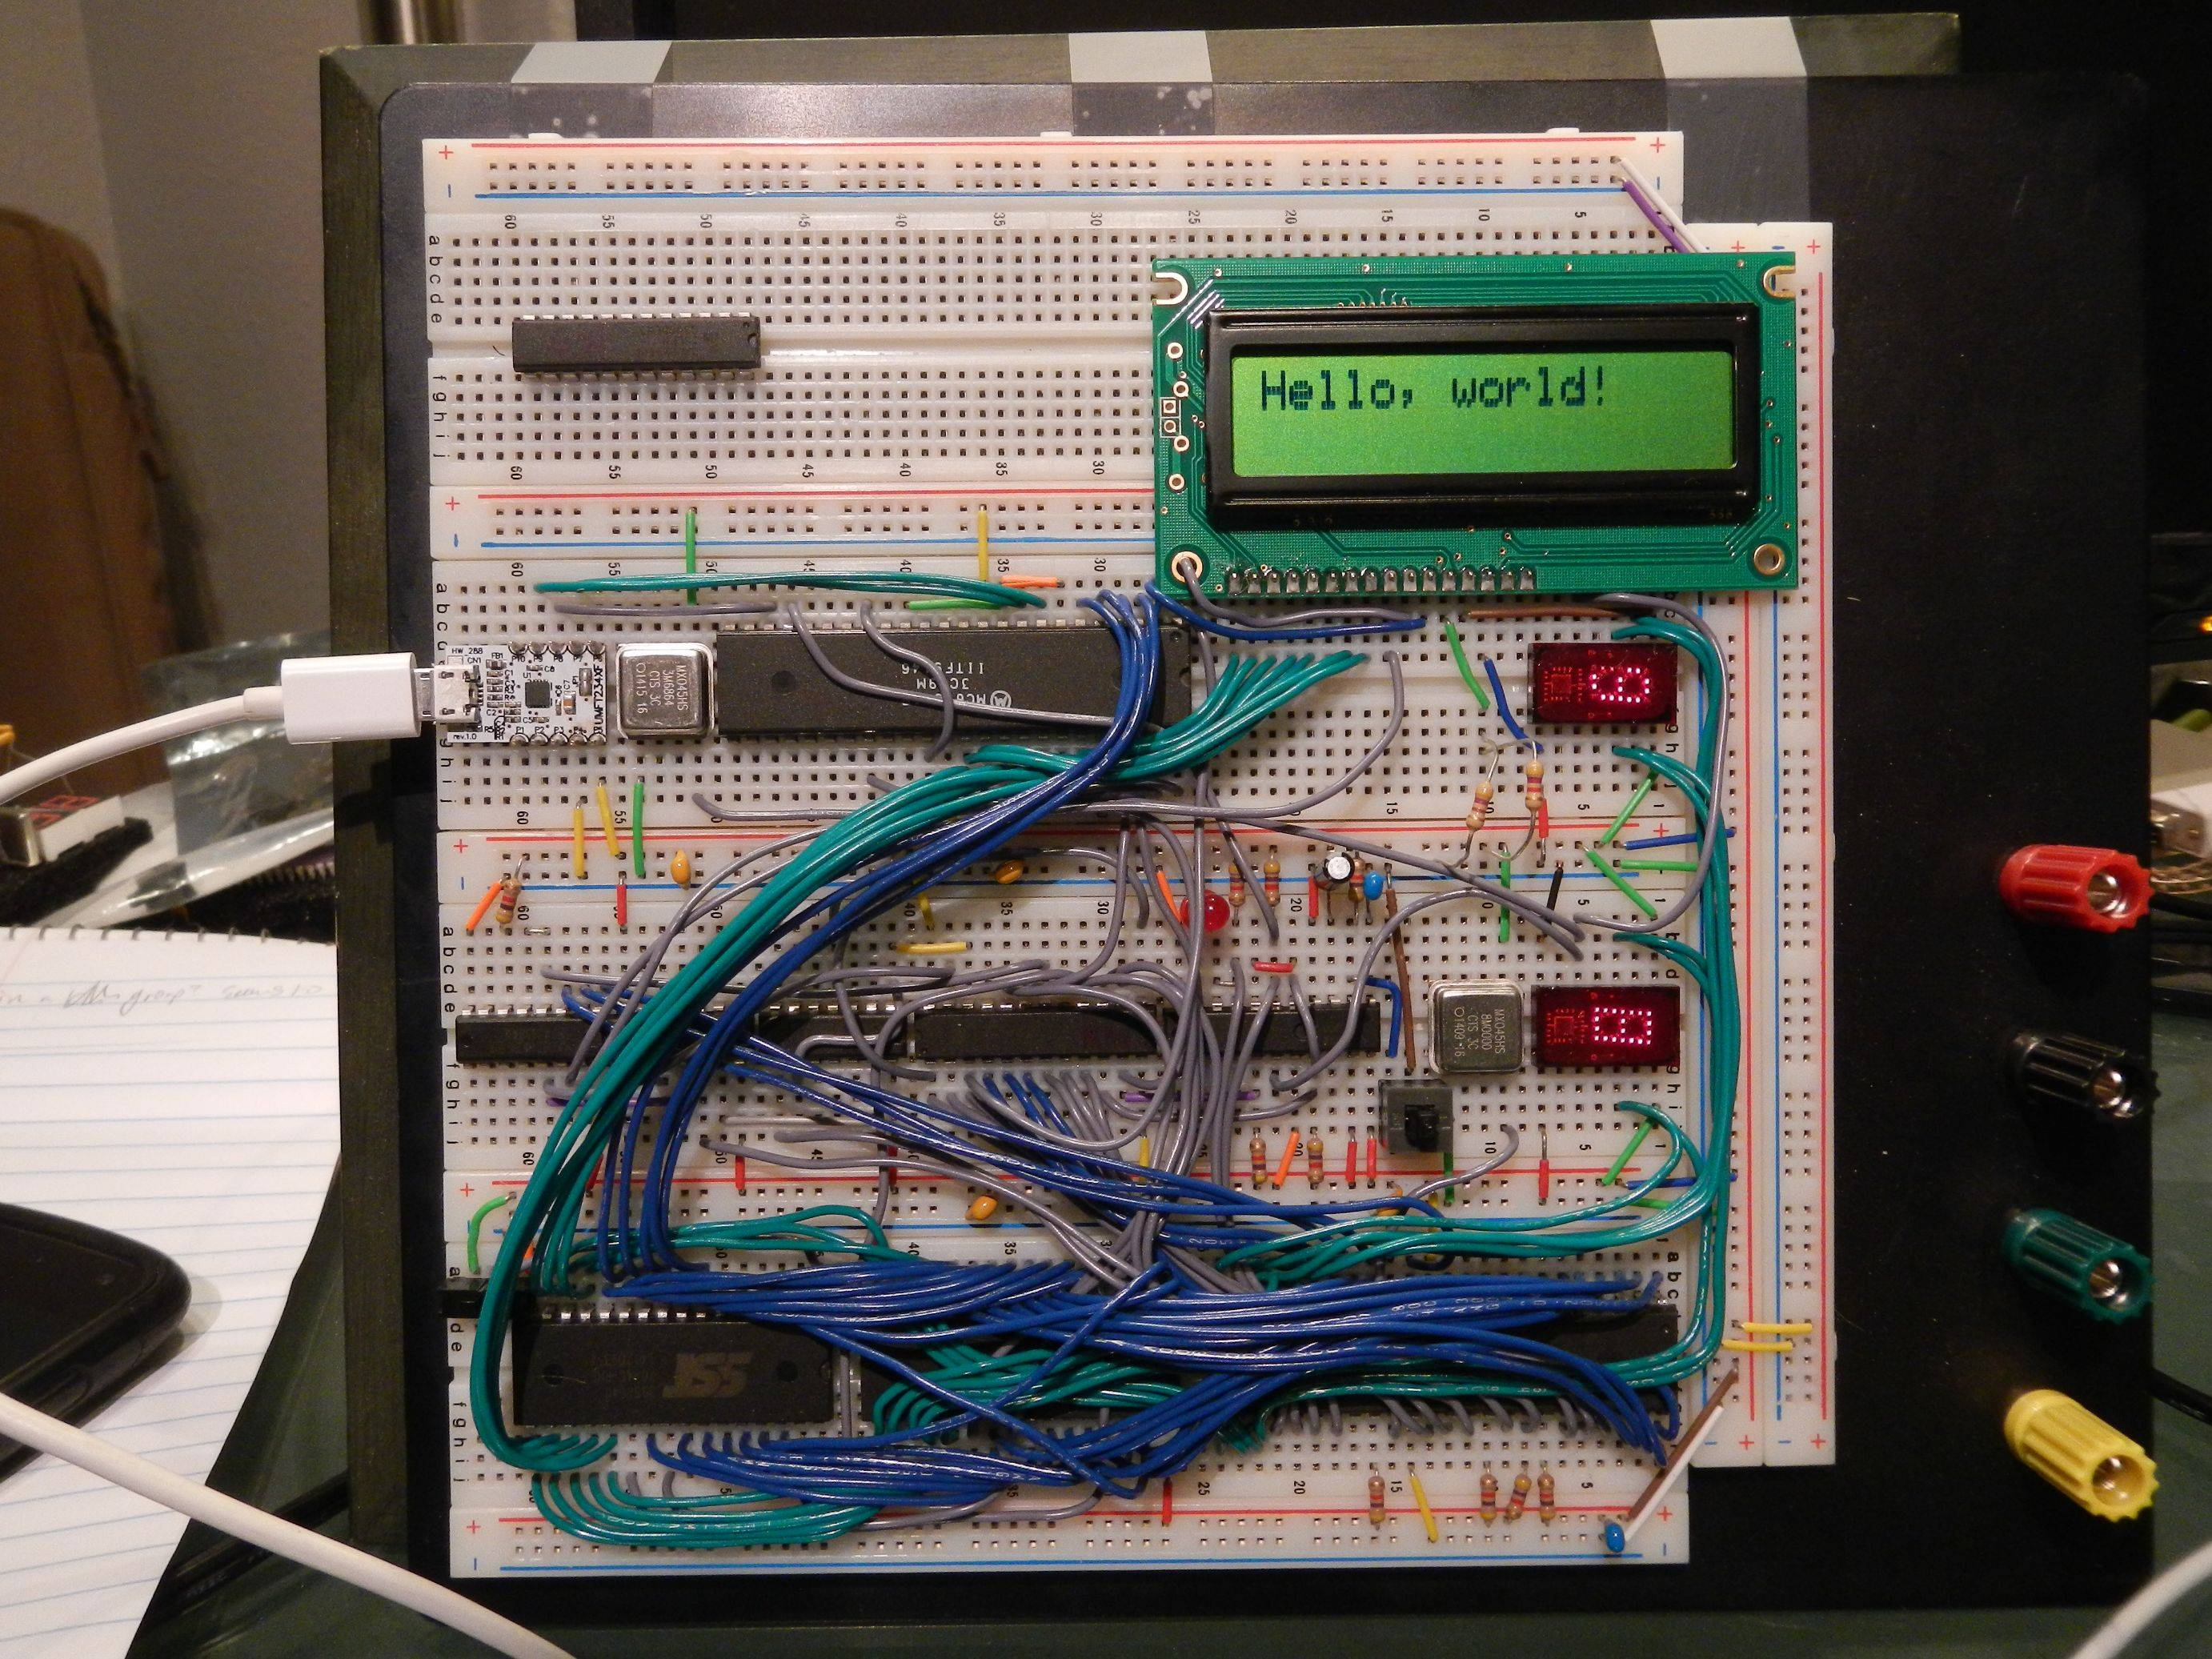
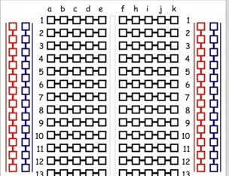
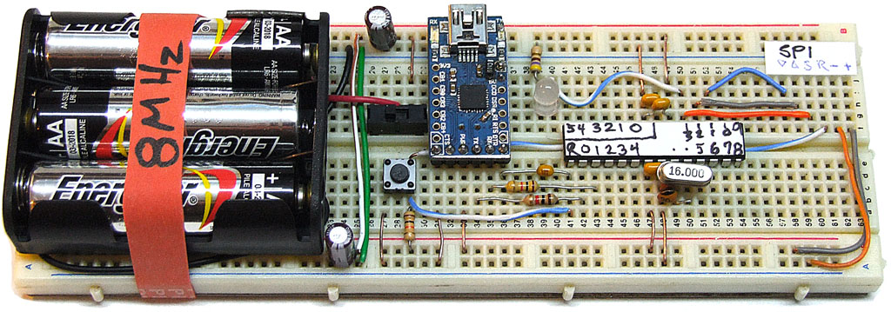
A3 – Electronics I
Solderless breadboard

